Slide 1

Stable Diffusion - Image to Prompts
TEAM 1
FNU MARIA POULOSE
DIVYA NALAM
HARSHITHA MOHANRAJ RADHIKA
SAJIT VALIYA KIZHAKKE

Slide 2
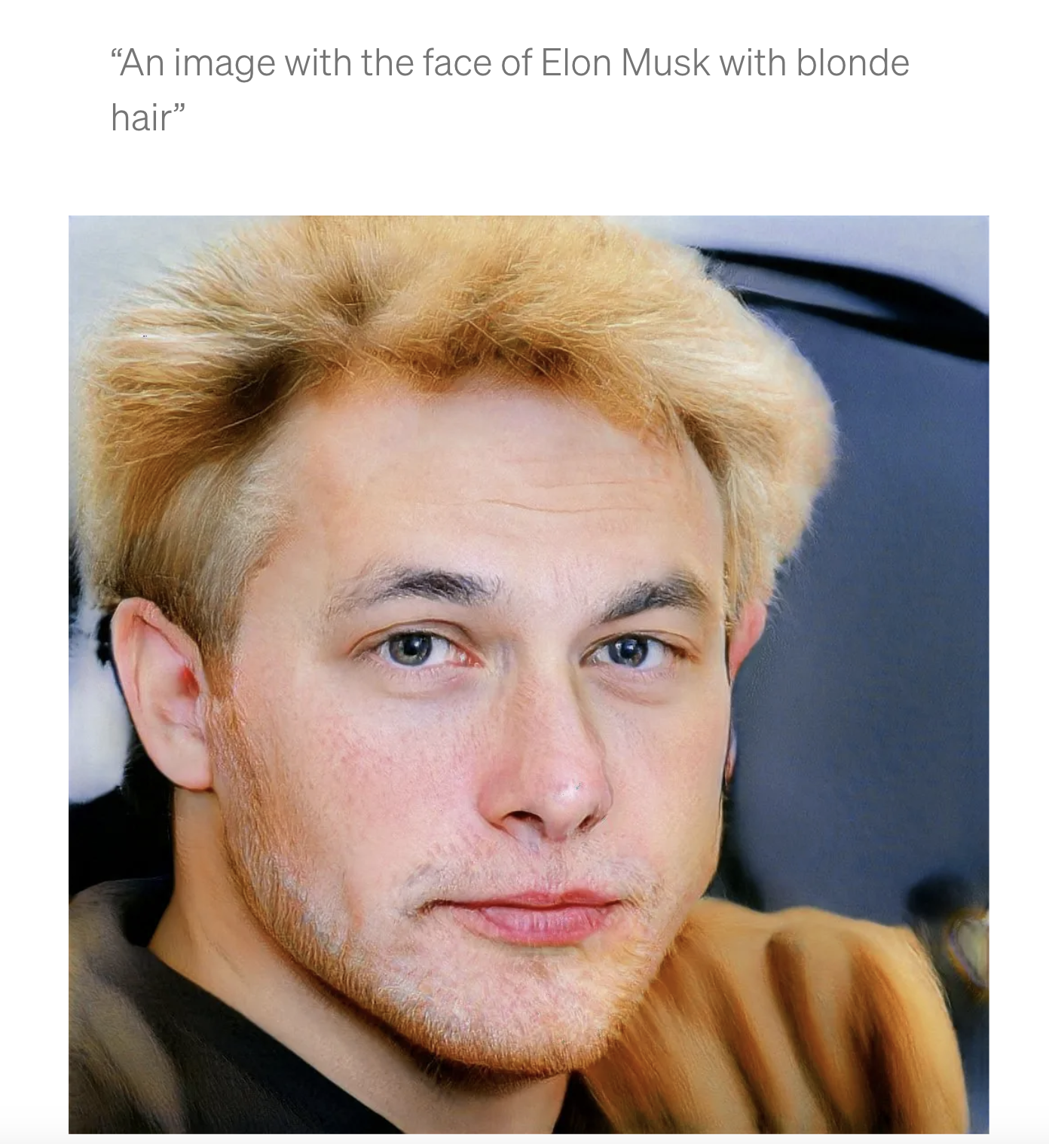
Introduction
DATASET: The pictures were produced in 50 steps at a resolution of 768x768 pixels using Stable Diffusion 2.0. The generated photos were reduced in size for the competition dataset to 512x512 pixels. The default settings have been kept untouched in the script that generated the photos.
Stable Diffusion - A text-to-image model using deep learning launched in 2022 by stability AI
Stable Diffusion 2 is based on OpenCLIP-ViT/H as the text-encoder
Primary goal is to produce detailed prompts conditioned on text descriptions.
Our aim is to develop a model that can accurately reverse the stable diffusion process
The embeddings of our prompts will be used to calculate prompt similarity robustly.
Source: https://towardsdatascience.com/generating-images-from-prompts-using-clip-and-stylegan

Slide 3
INTERESTING LINKS FOR STABLE DIFFUSION
https://dreamstudio.ai/- Stable Diffusion Image Generator
1
https://huggingface.co/spaces/pharma/CLIP-Interrogator - Prompt Generator
3
https://laion.ai/blog/large-openclip/ - Large Clip Models
2

Slide 4
Real world Applications
Image captioning: This project can be used to provide captions for pictures automatically. Such a feature would be beneficial in a number of areas, such as social media platforms, content management systems, and accessibility tools for users who are blind or visually impaired.
Visual Storytelling: Creating textual narratives or stories based on a series of photos can be done using the project as a foundation. This can be used to summarize movies, write children's novels, or come up with unique descriptions for photo albums.
Advertising and Marketing: This technology can be used to produce compelling marketing content, like as ad copy or product descriptions, to increase audience engagement and boost sales by providing contextually relevant and interesting prompts for photos.

Slide 5
Literature Review
PAPER 1: Diversity is Definitely Needed: Improving Model-Agnostic Zero-shot Classification via Stable Diffusion
The authors offer insights that MA-ZSC( Model Agnostic Zero-Shot Classification) performance may be enhanced by boosting the variety of photos in the produced dataset. Using a diffusion model that has already been trained, they suggest several changes to the text-to-image creation procedure that they refer to as our "bag of tricks" to improve variety. Significantly improved several classification designs, and the results are on par with those of cutting-edge models like CLIP. To validate their methodology, they tested CIFAR10 and CIFAR100.
PAPER 2: What’s in a Text-to-Image Prompt? The Potential of Stable Diffusion in Visual Arts Education
The authors have codified this novel way of producing art and assessed its potential for instructing art history, aesthetics, and methods by analyzing a collection of 72,980 Stable Diffusion prompts. According to this study, text-to-image AI can revolutionize how art is taught by opening up new, accessible channels for experimentation and artistic expression. It illustrates how AI may be used to improve art instruction. But it also raises important questions about who owns artistic works. As more and more work is created with the help of these instruments to protect artists' rights, it will be crucial to develop new legal and business structures.

Slide 6
Literature Review
PAPER 3: CoCa- Contrastive Captioners are Image-Text Foundation Models
The authors present CoCa, a simple design to combine contrastive loss with captioning loss while pretraining an image-text encoder-decoder foundation model. An image encoder extracts characteristics from pictures, and a text encoder, encodes the captions. The CoCa model is trained to increase the similarity between picture features and their related accurate captions while decreasing the similarity between wrong captions and image features.
PAPER 4: BLIP- Bootstrapping Language-Image Pre-training for Unified Vision-Language Understanding and Generation
The authors have introduced BLIP, a novel VLP framework adaptable to vision-language interpretation and generation operations. Bootstrapping the captions—where a captioner creates artificial text captions, and the filter pulls out the noisy ones—allows BLIP to use the noisy online data efficiently. They obtained cutting-edge outcomes on various vision-language tasks, including image-text retrieval, image captioning, and the VQA. BLIP also exhibits significant generalization abilities when applied in a zero-shot fashion to video language problems.

Slide 7
Related work
Radford et al. (2021), "Learning Transferable Visual Models From Natural Language Supervision" | CLIP (Contrastive Language-Image Pretraining) model is developed using a sizable dataset of images and the textual descriptions that go with them. The image encoder is a CNN that extracts visual features from the input images, while the text encoder is a transformer-based model that processes the textual descriptions. By maximizing the agreement (i.e., similarity) between the image and text embeddings for matching pairings while decreasing the agreement for non-matching pairs, the model learns to correlate the images with their descriptions.
Xu et al. (2015), "Show, Attend, and Tell: Neural Image Caption Generation with Visual Attention" | Neural network-based model for creating Image captions. The image encoder is a convolutional neural network (CNN) that extracts visual features from the input images, while the caption generator is a long short-term memory (LSTM) network that processes the visual features and generates the textual descriptions. The model creates more accurate and in-depth captions by focusing on different areas of the image with selective attention for predicting the captions.
Deep Visual-Semantic Alignments for Generating Image Descriptions" by Karpathy et al. (2015) | Algorithm described in this paper learns to create textual descriptions of images by matching visual regions with words in a phrase. The authors propose a novel training procedure that jointly optimizes both the image encoder and sentence generator by maximizing the likelihood of the ground-truth descriptions conditioned on the input images. During this process, the model uses a deep neural network that learns to align different image regions with their corresponding words or phrases in the textual descriptions.

Slide 8
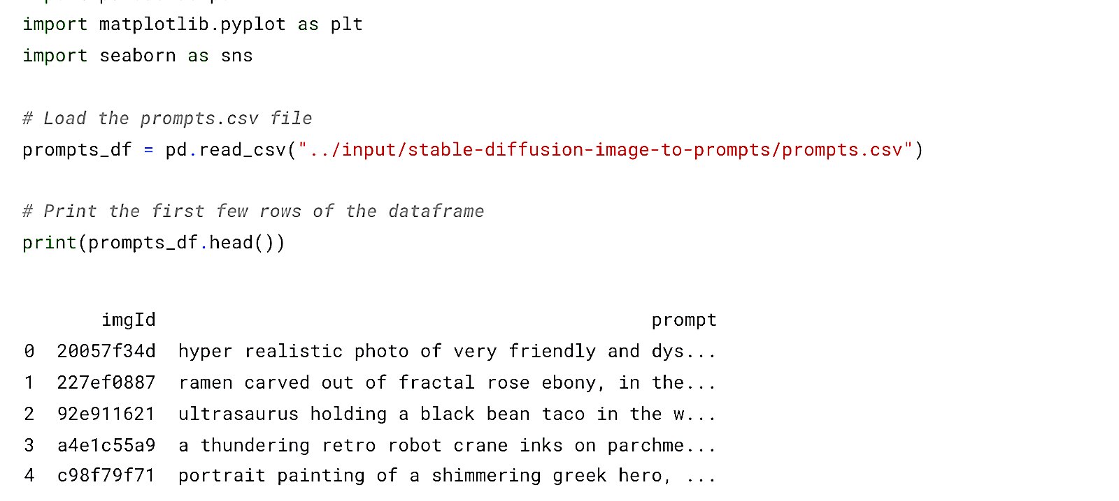
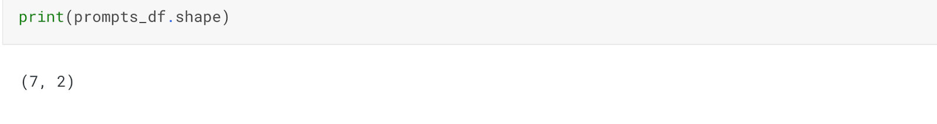
Data Exploration
Dataset:
The prompts.csv contains the images in the training dataset and their corresponding prompts that were used initially to derive the images.
Shape of the DataFrame:
The dataframe contains 7 rows which are the 7 images derived as a result of stable diffusion and the 2 columns are the imgId and the corresponding prompts

Slide 9
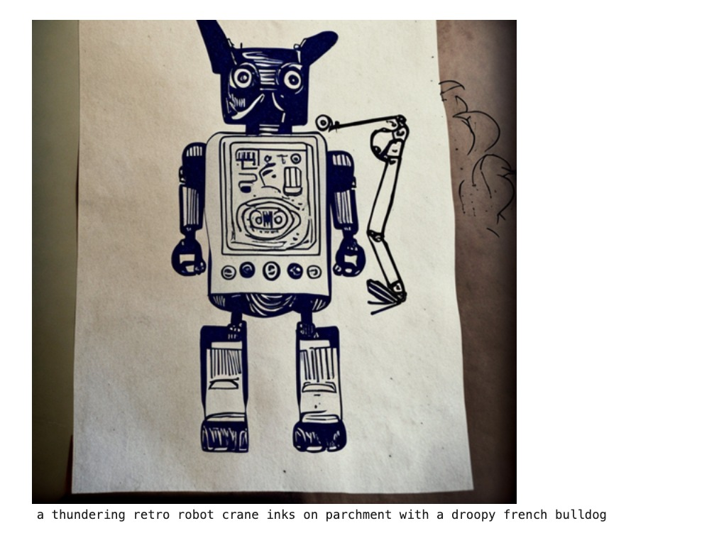
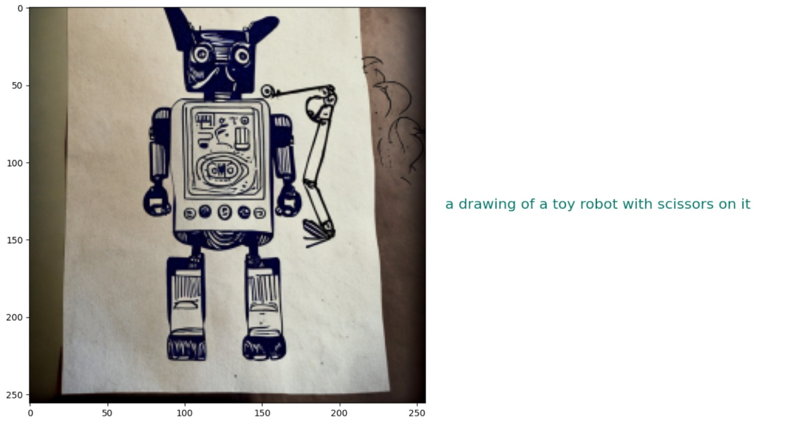
Data Preprocessing
Image Resizing: To ensure that all images have the same dimensions, we resize each image to a predefined target size (target_size = (256, 256)). This step is essential because most deep learning models require consistent input dimensions to process the images effectively.
Pixel Value Normalization: After resizing the images, we normalize the pixel values to fall within the range of 0 to 1 by dividing each pixel value by 255. This normalization step is crucial for deep learning models, as it helps in improving the model's convergence during training and stabilizing the gradients.

Slide 10
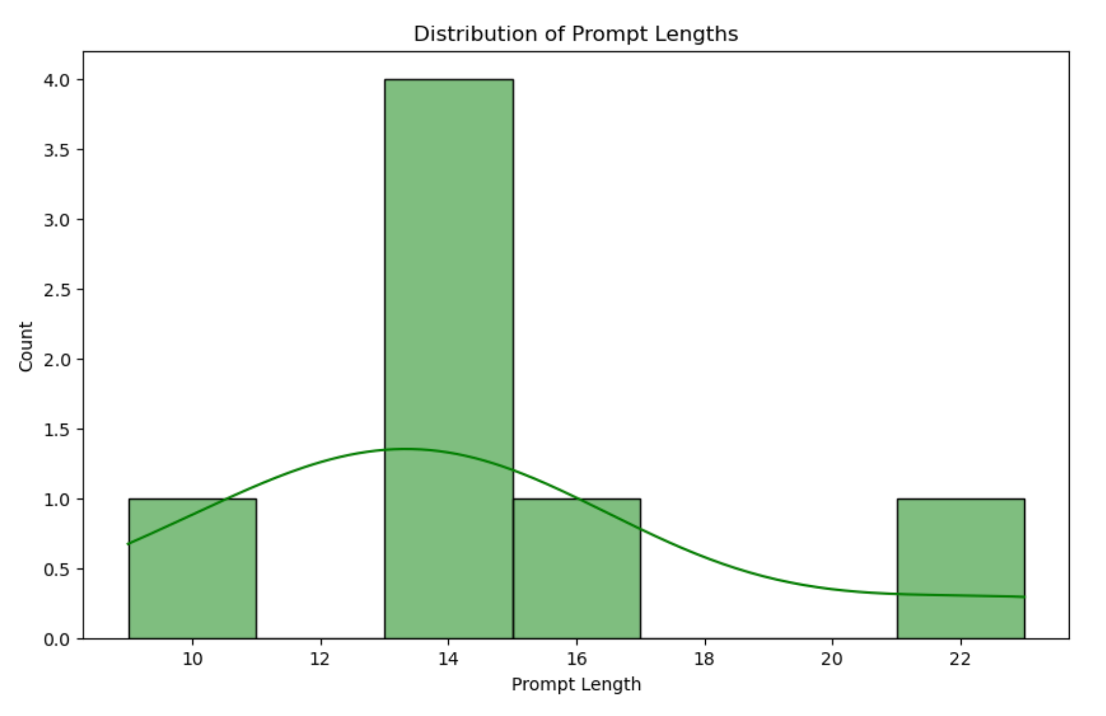
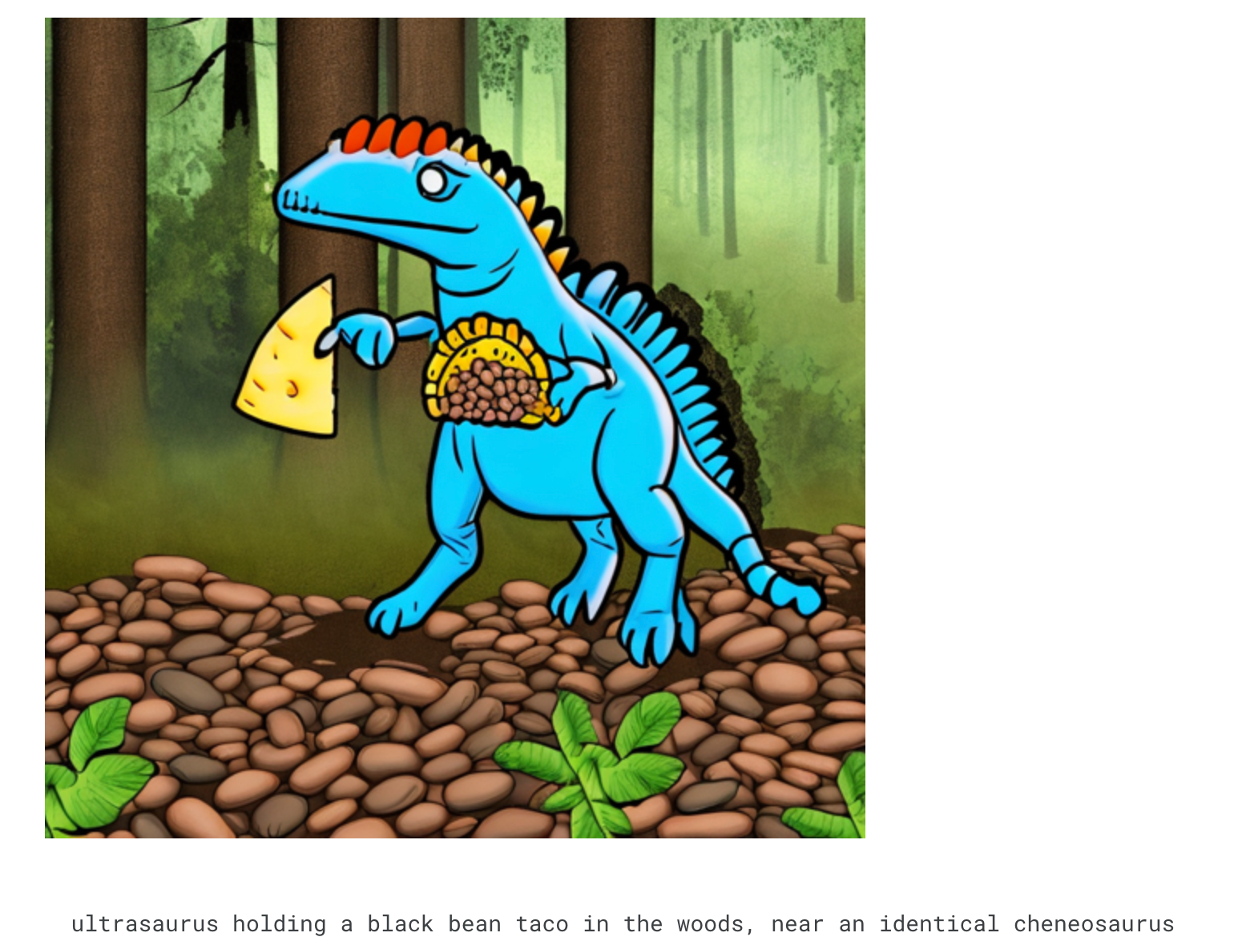
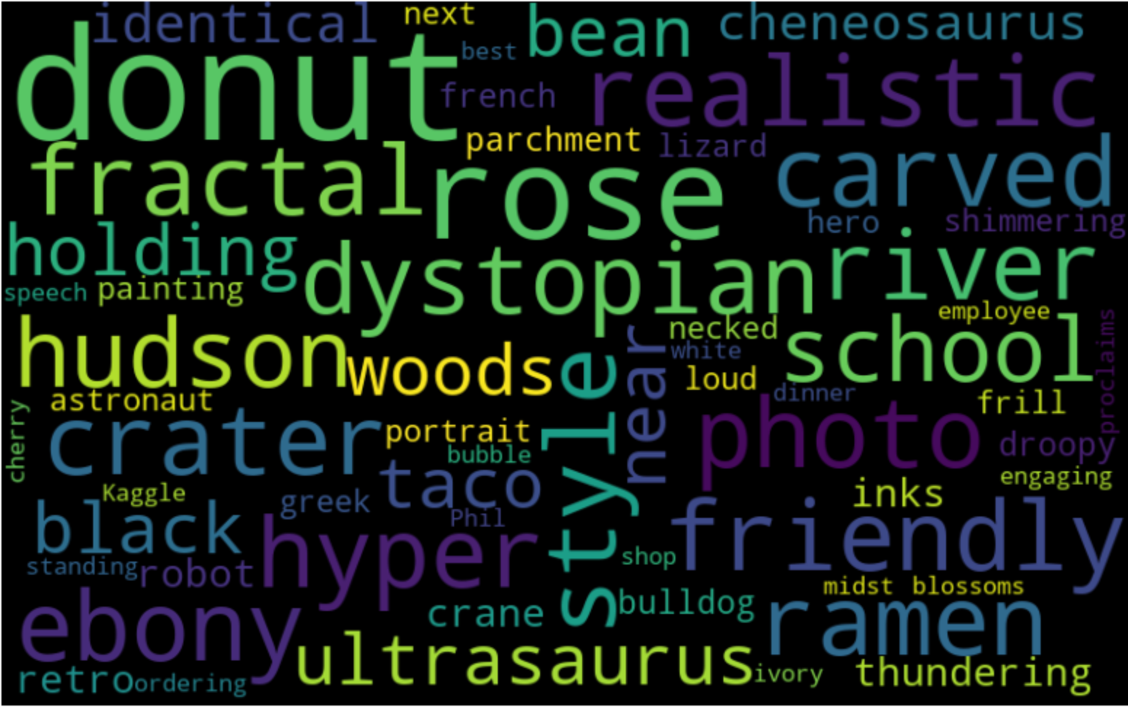
Data Visualization
IMAGE AND PROMPT
DISTRIBUTION OF THE PROMPT LENGTH
WORD CLOUD
To calculate the length of each prompt and plots the distribution of prompt length. To get an idea of how long or short the prompts are and their distribution.
Check the most frequent words in the prompts appear larger using word cloud. The most recurring themes or subjects in the text data can be spotted immediately by using this visualization.

Slide 11
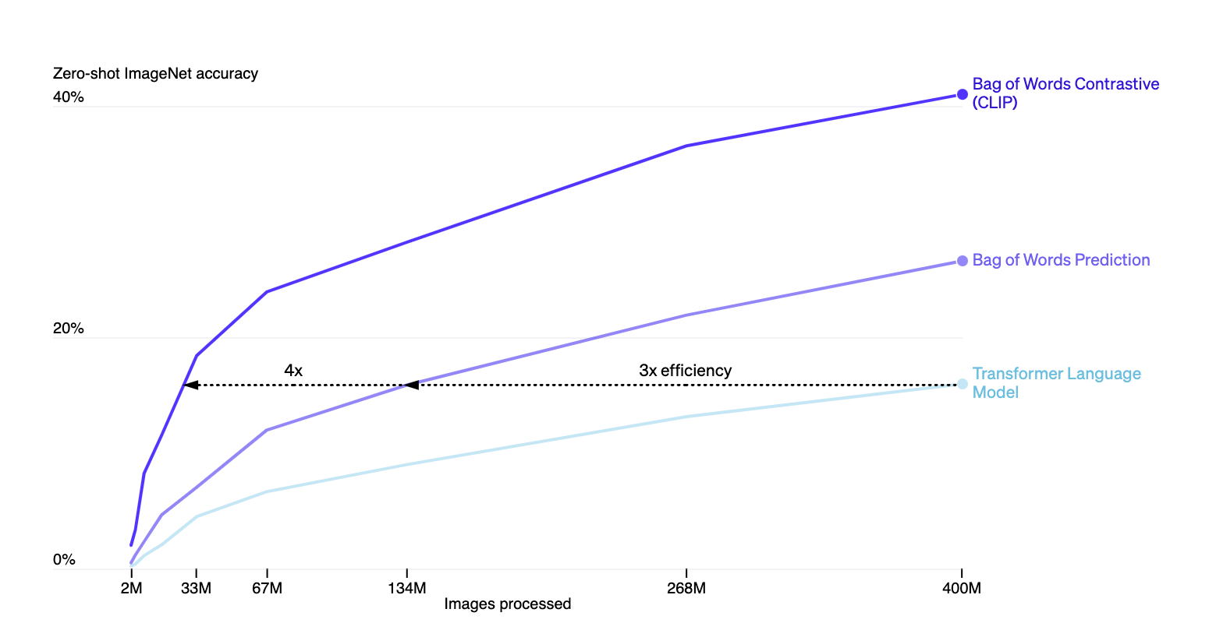
Models
CLIP(Contrastive Language–Image Pre-training):
CLIP proposed by Open AI is a new neural network and it effectively picks up visual notions from natural language supervision.
ADVANTAGES: CLIP is highly efficient, CLIP is flexible and general
LIMITATIONS: CLIP does not generalize well for photos not included in its pre-training dataset
Applications: Zero-shot image classification, image and text retrieval
Zero-shot CLIP only achieves 88% accuracy when tested on handwritten digits from the MNIST dataset, far less than the dataset's 99.75% human accuracy.

Slide 12
Coca + Clip Model
Utilizing 'open_clip_wheels' directory: containing precompiled Python wheels for OpenAI CLIP library.
Utilizing 'SentenceTransformer' module to sentence embedding and creating an instance.
Defining config class with parameters like device, seed, embedding length, model name and others.
Creating unique keys for each embedding.
Loading pre-trained CLIP model and creating image transformation pipeline.
Generating prompts, encoding prompts to embedding matrix and finding cosine similarity.

Slide 13
Results for Coca + Clip Model
Original
Generated

Slide 14
Models
BLIP (Bootstrapping Language-Image Pre-training)
The activities that the BLIP model can do includes Answering Questions Visually, image-text matching (image-text retrieval), captioning of images.
In BLIP, an encoder-decoder and a multi-task model are combined into a multimodal system that can perform three modes.
Unimodal encoders: Encoders that encode text and graphics individually. A vision transformer is the image encoder. It uses the same text encoder as BERT.
Image-grounded text decoder: This replaces the bi-directional self-attention layers in the text encoder with causal self-attention layers.
Image-grounded text encoder: This injects visual information by inserting a cross-attention layer between the self-attention layer and the feed-forward network for each transformer block of the text encoder.

Slide 15
Blip Model
The Blip The model receives an input image, converts it to pixel values, and then creates a caption (prompt) for that image.
After that, other tasks like computing embeddings are performed using the generated prompt.
The Sentence Transformer model computes an embedding for a sentence given as input (in this case, the generated prompt).
After that, the embeddings are put to use in downstream tasks like clustering and similarity judging.
Combining these models enables the code to process both picture and text input, and the resulting embeddings may be applied to a number of different tasks, including ranking, grouping, and comparison.

Slide 16
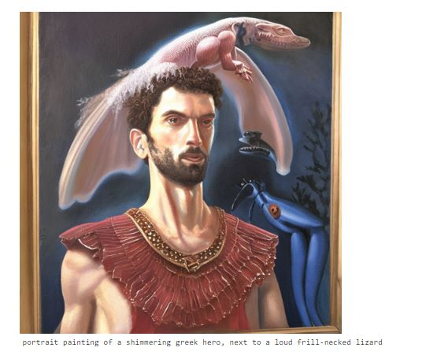
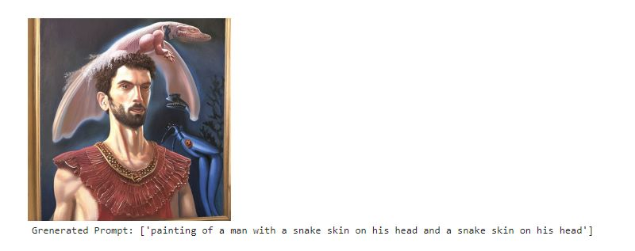
Results for Blip Model
Original
Generated

Slide 17
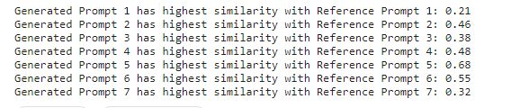
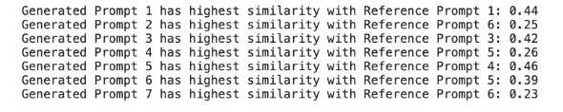
MODEL EVALUATION
Cosine similarity for Blip Model
Cosine similarity measures the angle between two non-zero vectors in a multi-dimensional space, with higher values indicating greater similarity.
A similarity_scores matrix was created to store the cosine similarity values between each generated prompt and each reference prompt.
Cosine similarity for Coca + Clip Model

Slide 18
Conclusion
This project generated text prompts for Images using the cutting-edge deep learning models Blip and Coca + Clip.
The project showed the potential for numerous real-world applications, such as image captioning, visual storytelling, advertising, content moderation, and more by utilizing the power of these sophisticated models.
The findings demonstrate how well vision and language models can be combined to produce interesting and contextually appropriate textual representations for images.
This would ultimately contribute to the continued evolution of artificial intelligence.

Slide 19
Model Justification
Performance: In producing insightful text prompts for images across multiple domains, both Blip + Clip and Coca + Clip have shown strong performance. They are a good fit for this project because it aims to create interesting and accurate textual representations for a variety of photos because they can deliver high-quality prompts.
Flexibility: The Blip + Clip and Coca + Clip models are flexible to many application fields because they can be tweaked on a variety of datasets. This adaptability enables the investigation of many use cases and the potential to address particular difficulties in producing text prompts for images.
Ease of Integration: Because pre-trained models are available and well-known deep learning frameworks like PyTorch offer support, it is simple to integrate the models into the project pipeline. The development process can be accelerated because to the integration's simplicity, and the models' implementation and evaluation take less time and effort.

Slide 20
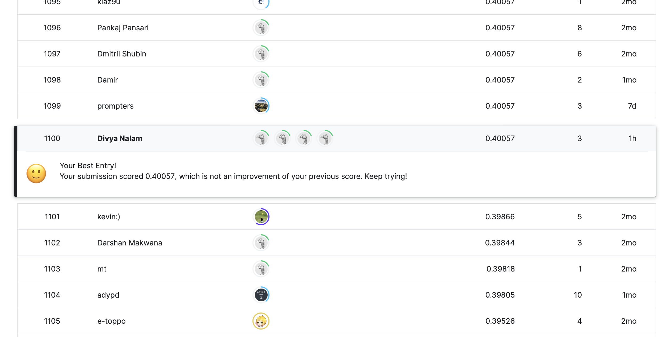
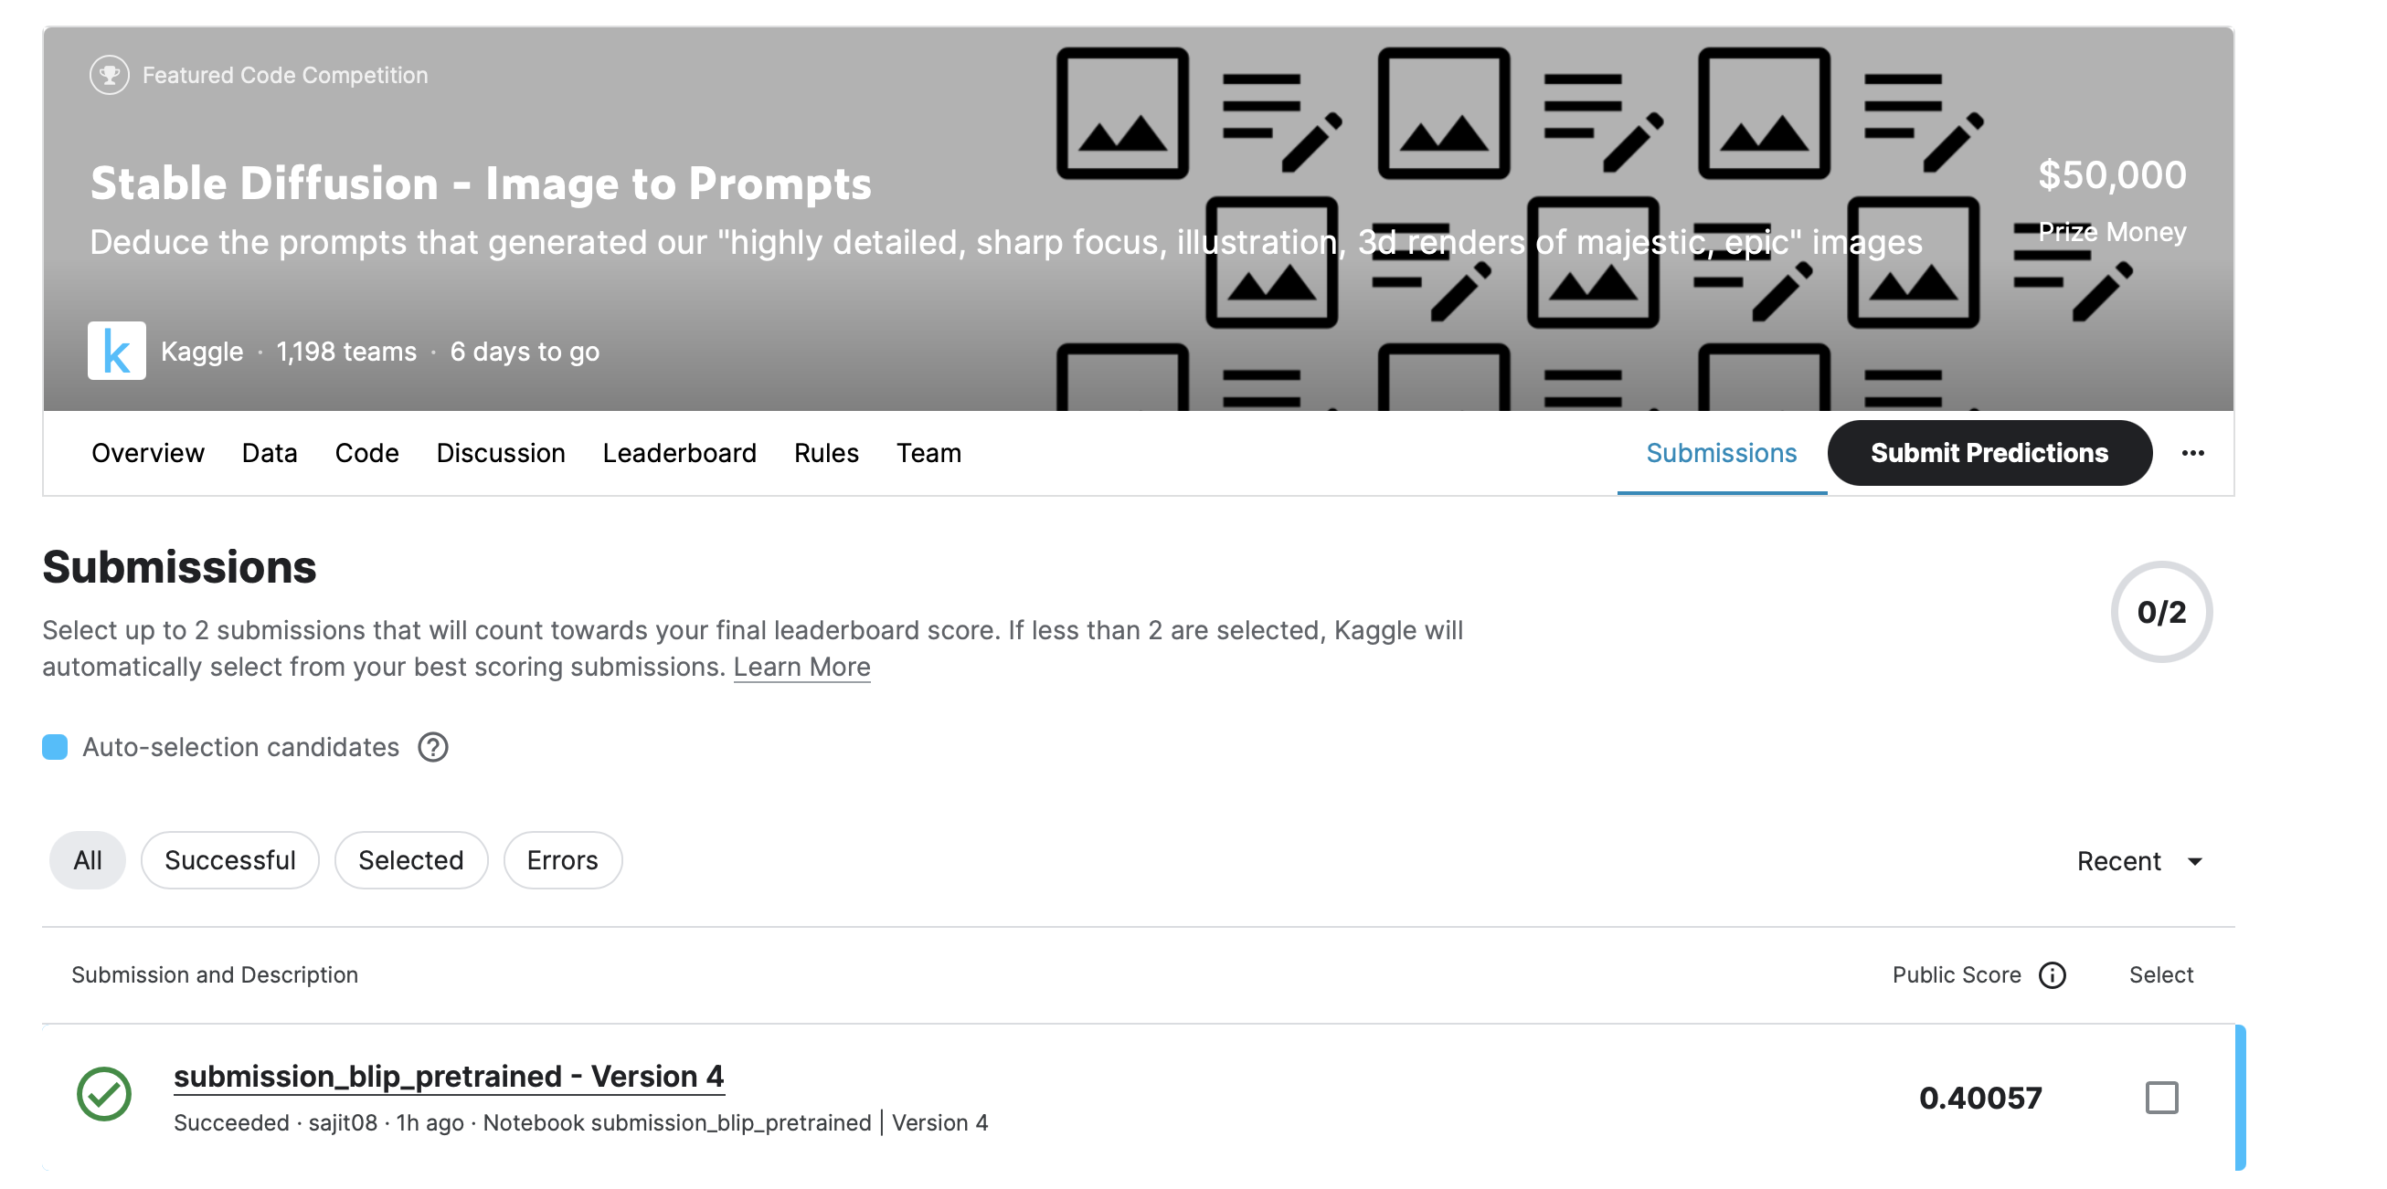
Kaggle Score and Position

Slide 21

THANK YOU!

